Slide 1


Controlador de Semáforos
Realizado por: Pedro Sousa e Leonardo Hügens

Slide 2
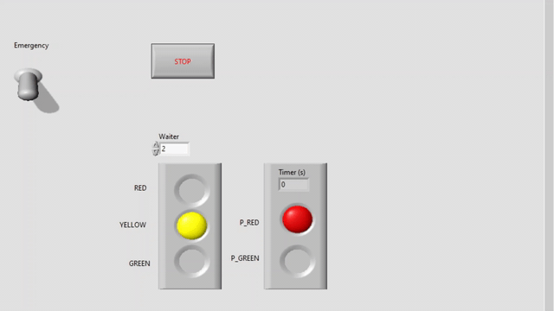

Alpha_0.1

Slide 3
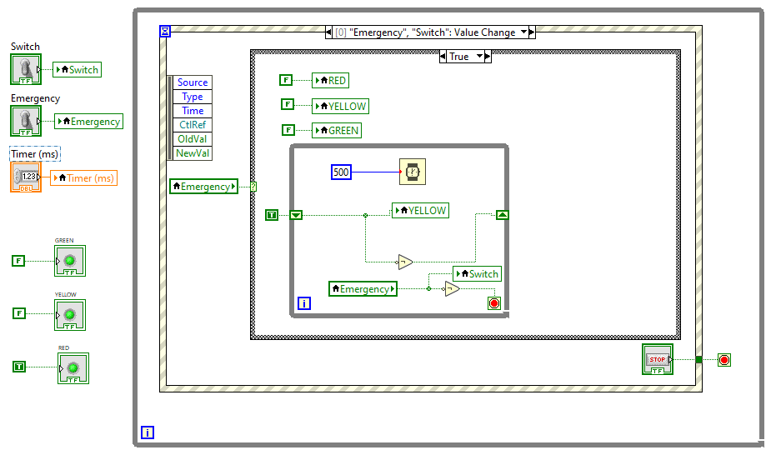
Alpha_0.2

Slide 4
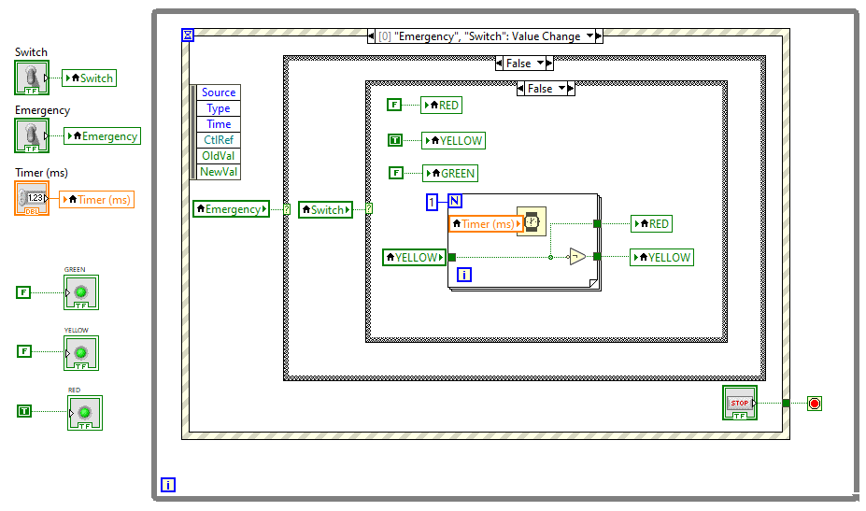
Alpha_0.2

Slide 5

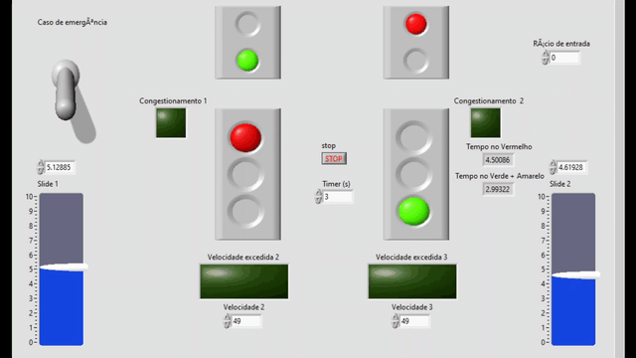
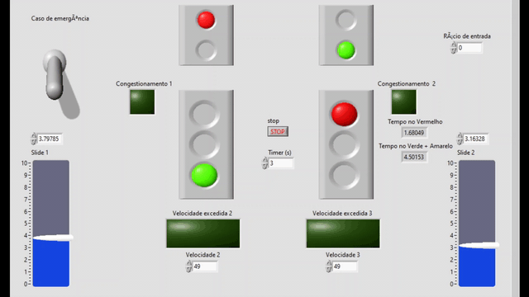
Alpha_0.3

Slide 6
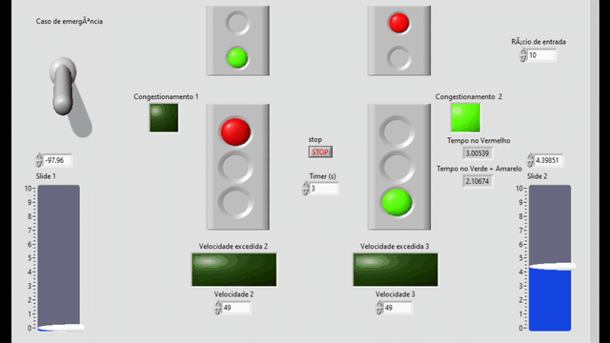
Alpha_0.3

Slide 7
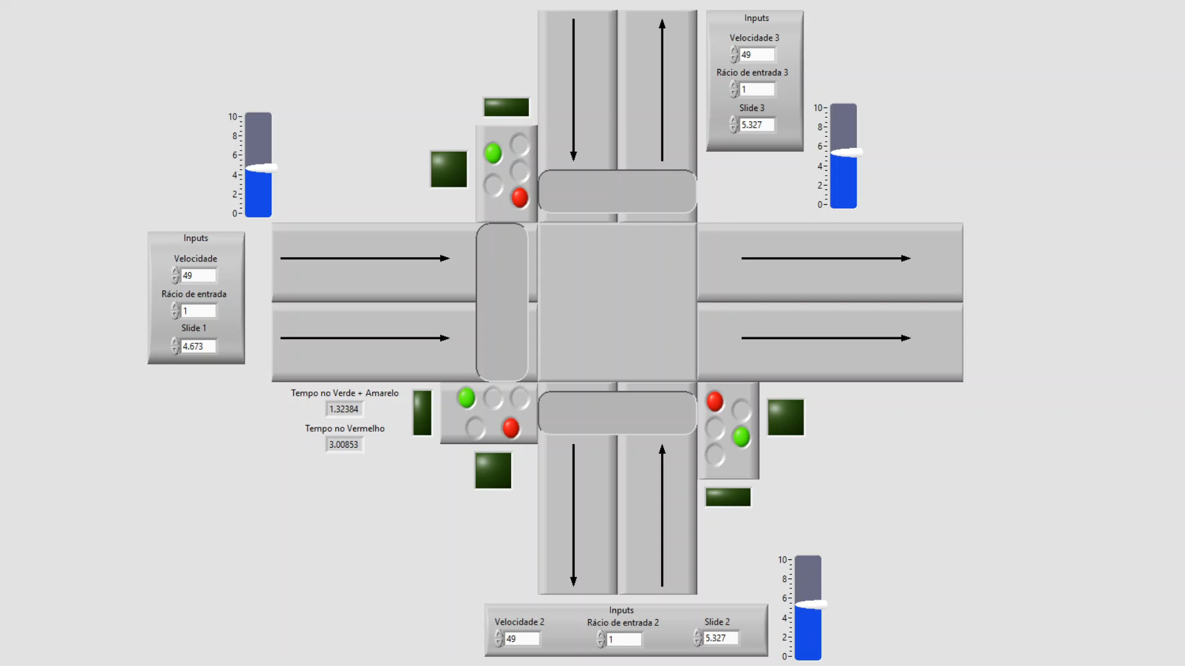
Alpha_0.4

Slide 8
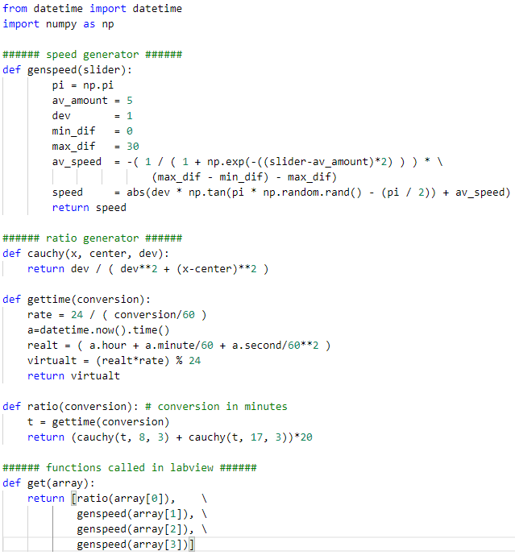
Alpha_0.5,0.6

Slide 9
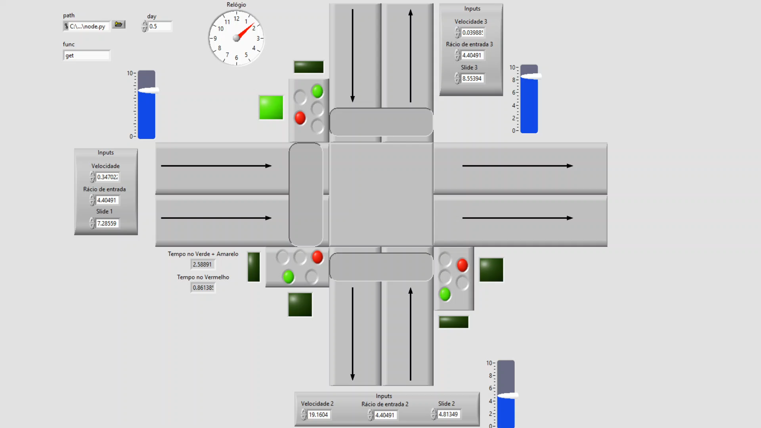
Alpha_0.6

